Slide 1


Slide 2
Problem Statement
We’ll be analysing and visualizing higher education students’ performance data for educational sciences to derive insights to predict student’s end-of-term performances.
To check how the parental level of education can affect the performance of the student socioeconomic disadvantage, test preparation courses affect the student’s performances in the exams.

Slide 3
Data Pipeline (Program’s Structure Analyzing and GUI Constructing)
Programming/working environment:
We used python programming language for pre-processing as we downloaded the data in the numerical format and converted to categorical format by using the string replace function ,and for visualization used tableau as it offers drag-and-drop functionalities for building charts and dashboards.
The dashboard created in this project was conducted with tableau public. Tableau public enables interactive data visualization and focuses on business intelligence. We have used dataset to draw information and create dashboard accordingly. It contains higher education students performance evaluation dataset the data was collected from the faculty of engineering and faculty of educational sciences students in 2019. The purpose is to predict students' end-of-term performances.
Dataset information
Data Set Characteristics: | Multivariate | Number of Instances: | 145 | Area: | Social
Attribute Characteristics: | Integer | Number of Attributes: | 29 | Date Donated | 2021-01-30
Associated Tasks: | Classification | Missing Values? | N/A | Number of Web Hits: | 20563

Slide 4
Attributes in Dataset
1-10 of the data are the personal questions, 11-16. questions include family questions, and the remaining questions include education habits.
Student Age
Sex
Graduated high-school type
Scholarship type
Additional work
Regular artistic or sports activity
Total salary if available
Transportation to the university
Accommodation type in Cyprus
Mothers education
Fathers education
Number of sisters/brothers
Parental status
Mothers occupation employee,
Fathers occupation
Weekly study hours
Reading frequency (non-scientific books/journals
Reading frequency (scientific books/journals)
Attendance to the seminars/conferences related to the department
Impact of your projects/activities on your success
Attendance to classes
Taking notes in classes
Listening in classes
Discussion improves my interest and success in the course
Flip-classroom: ( not useful, useful ,not applicable)
Cumulative grade point average in the last semester
Expected Cumulative grade point average in the graduation
Course ID
OUTPUT Grade

Slide 5
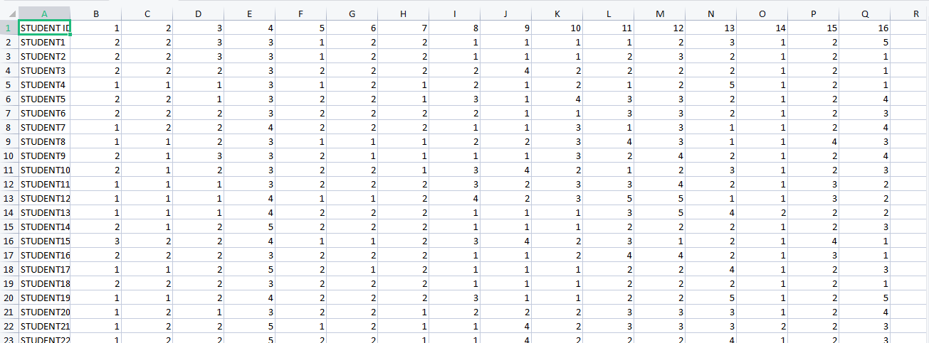
Dataset Before Conversion

Slide 6
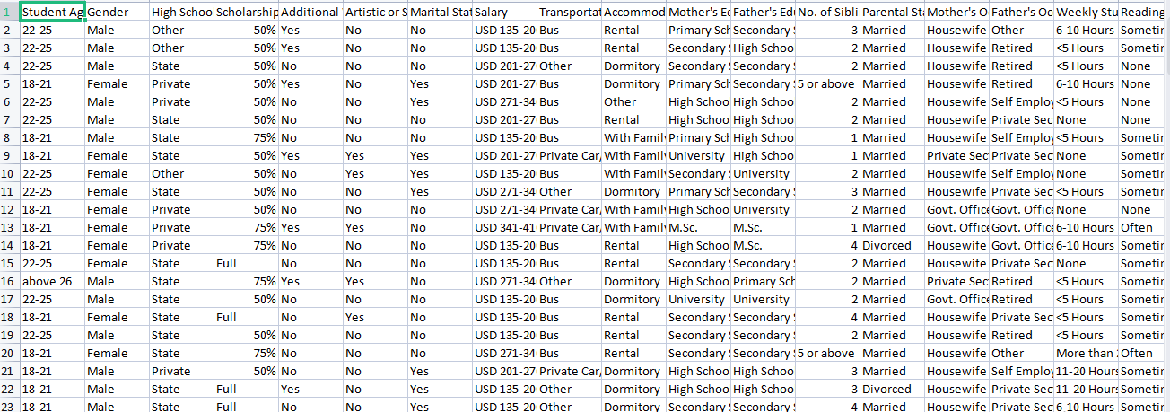
Data-set After Conversion(Final Dataset)

Slide 7
Descriptive Statistics
The substage of data understanding is summarizing the attributes of the data in the form of visuals and graphs which could give a quick reference to its pattern of distribution. Using the visual way is advantageous in understanding the data, patterns, trend and overall distribution for the dataset.

Slide 8
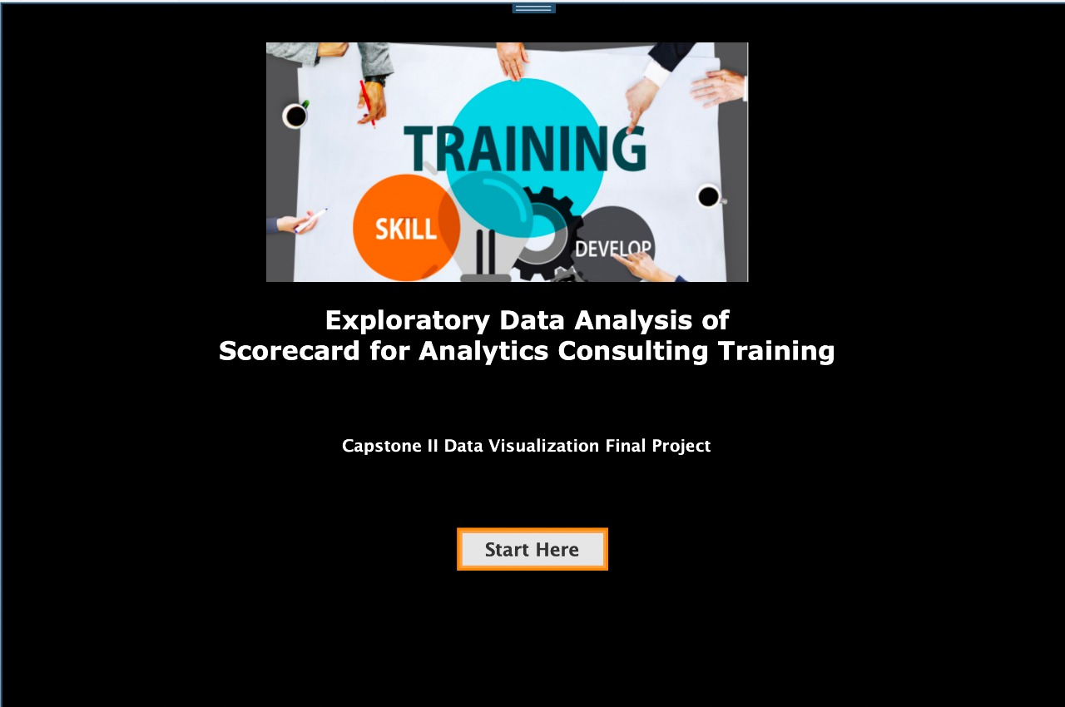

Slide 9
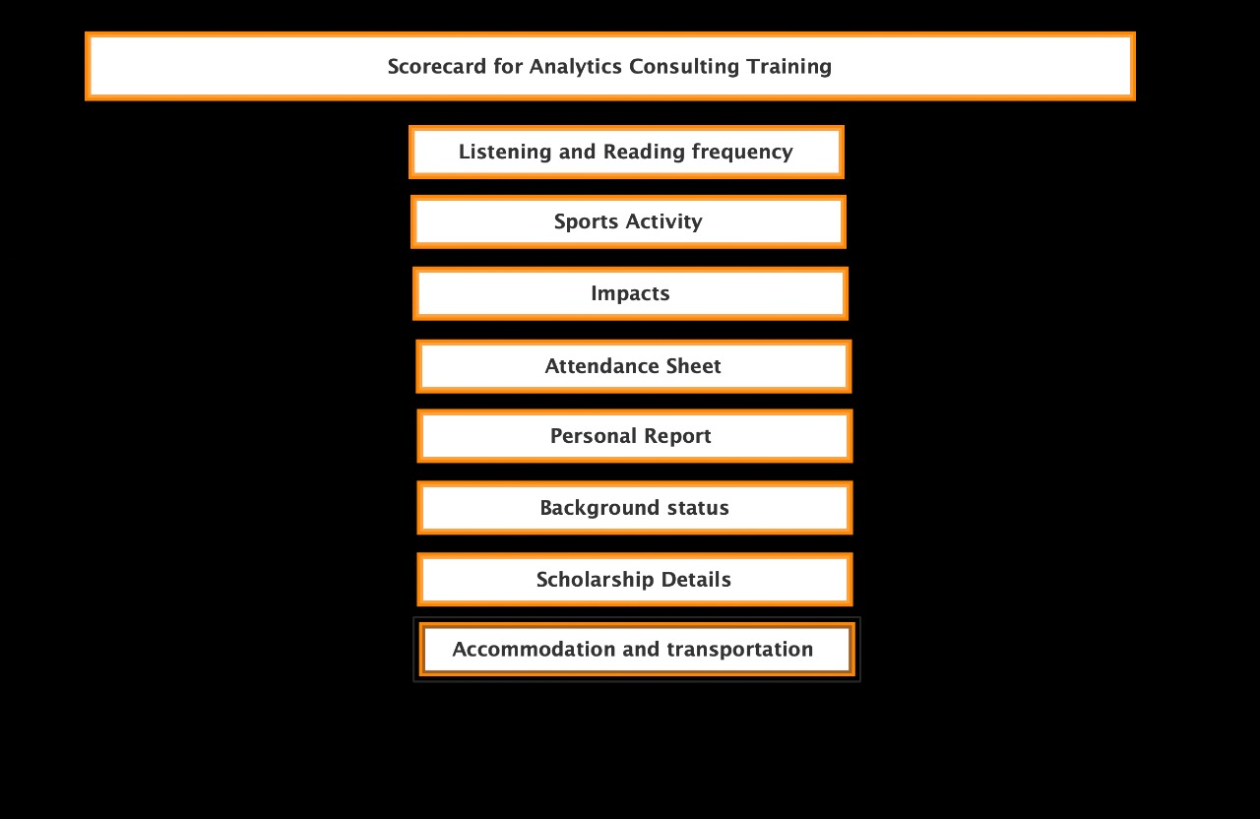

Slide 10
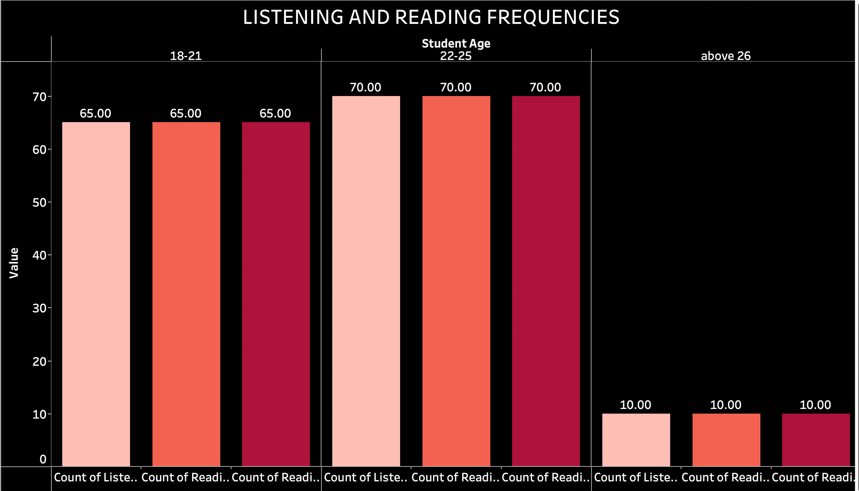

Slide 11
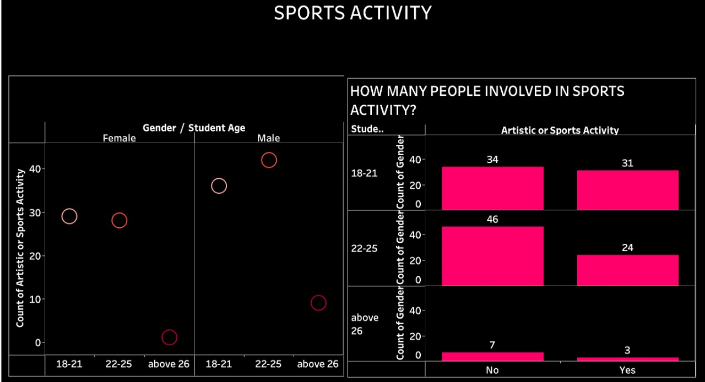

Slide 12
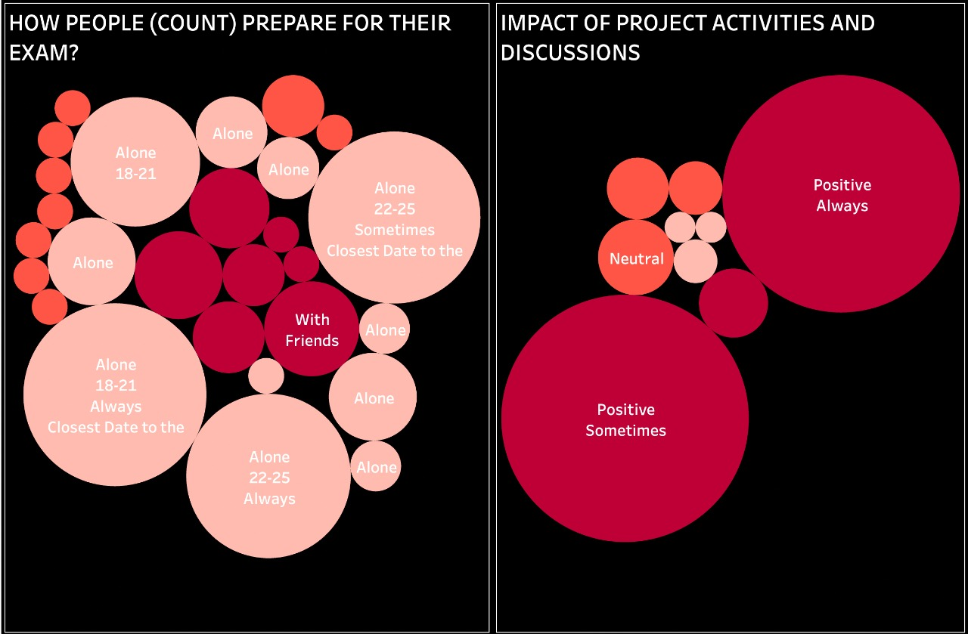

Slide 13
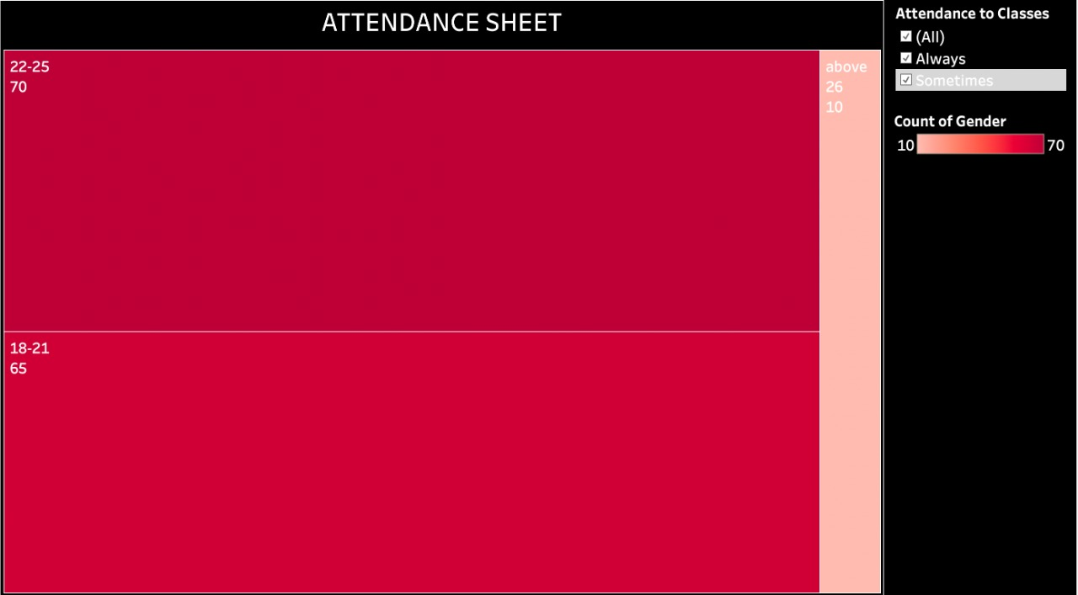

Slide 14
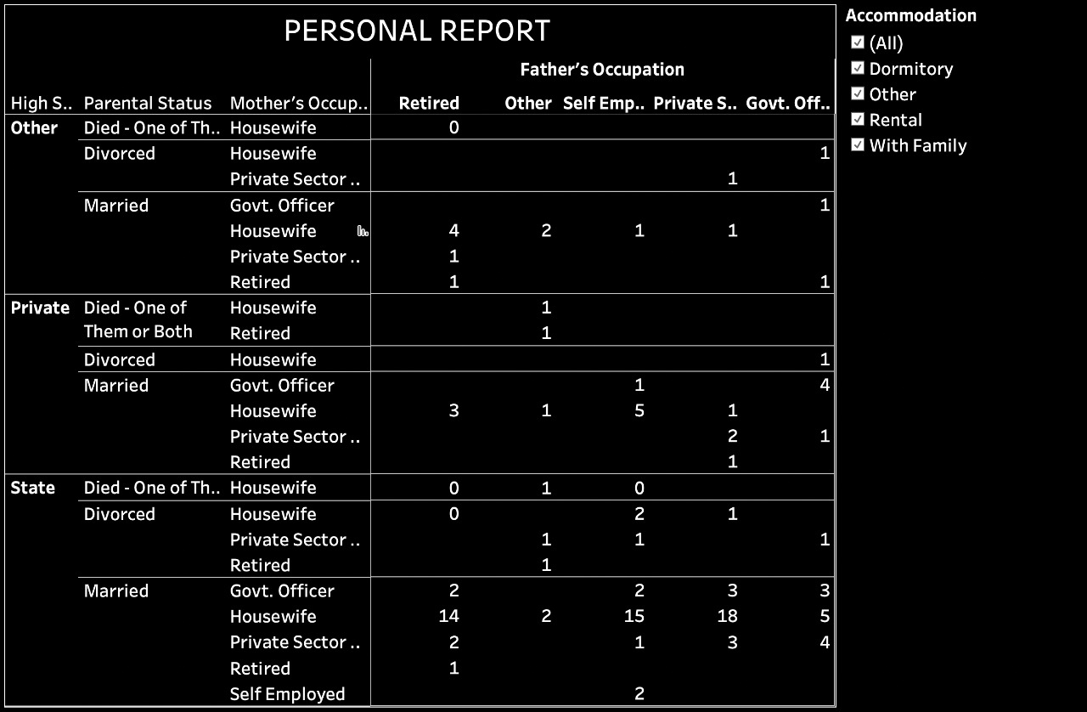

Slide 15
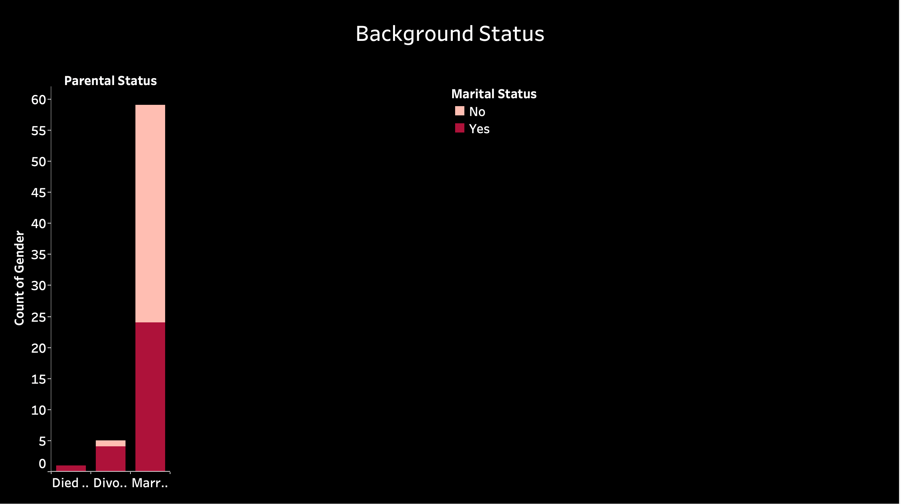

Slide 16
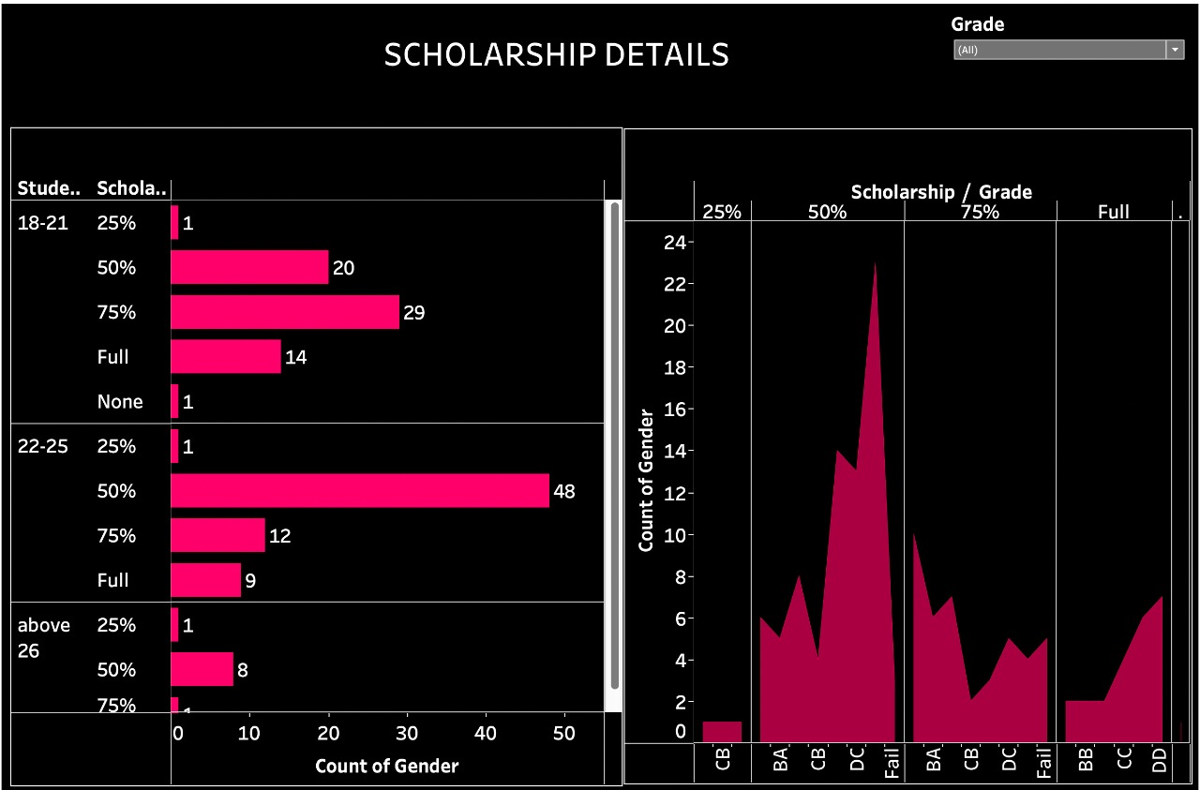

Slide 17
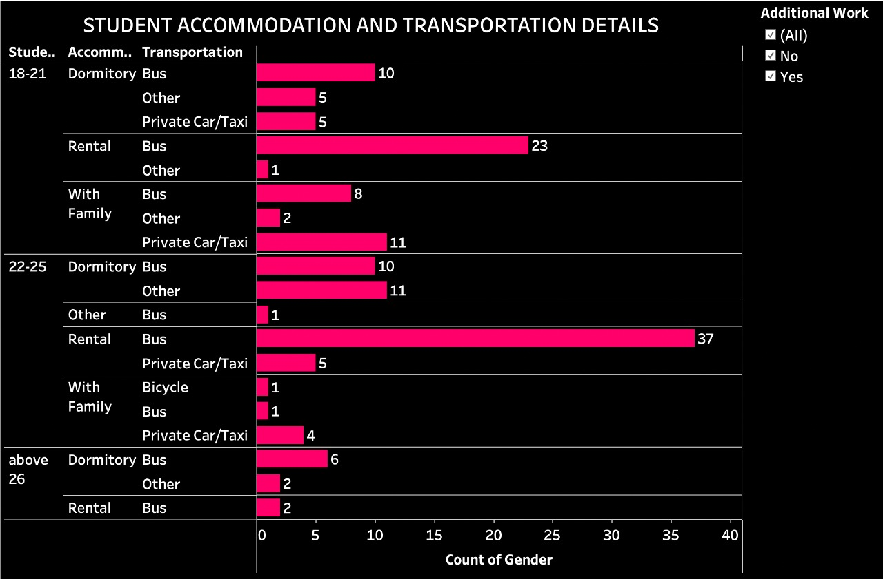

Slide 18
Conclusion
This analysis has taught us that, factors such as parental level of
education,
socioeconomic disadvantage,
test preparation courses affect the students’ performances in the exams.
But there are many exceptions as well. There are students with a low parental level of education scoring full marks.

Slide 19
Future Scope
This project was initiated in order to better understand the data of Higher Education Students Performance and how does the institute respond to student queries and complaints. The dashboard can easily be updated with new data. This project has been made to suggest and develop some tools, which could be useful to the institute. The findings obtained from the dashboard can help improve institutional services and experiences, thereby strengthening the relationship between the educational institution and it's students . The theory and understanding obtained from the project can be applied to different data representing different educational institutions.

Slide 20
References
Dataset link: https://archive.ics.uci.edu/ml/datasets/Higher+Education+Students+Performance+Evaluation+Dataset
Tableau link: https://public.tableau.com/app/profile/anshika4020/viz/ScorecardforAnalyticsConsultingTraining/Dashboard9?publish=yes

Slide 21
Roles and Responsibilities
NAME | ROLE
Anshika Aggarwal | Data visualization , Data Pipeline , written insights, future -scope and conclusion
Vaidehi Tiwari | Data visualization, written insights
Vaishnavi Sukhatme | Data extraction (Found the data set)and Presentation
Vasudha Singh | Data cleaning (pre-processing part)
Muskan Thapa | Presentation ,Problem Statement
Rohan Sitaram Jagtap | Helped in writing stats

Slide 22
THANK YOU!

